Slide 1
Open Source Tools for Data Analysis
With an example using R

Slide 2
Contents
01 | Data Analysis | P. 4
02 | Using R for Data Analysis | P. 8
03 | Online Resources | P. 13
04 | R: Interactive Data Analysis Tutorial | P. 16
05 | Python: Using Jupyter Notebooks | P. 26
06 | GitHub: Version Control and Collaboration | P. 29

Slide 3
01
Data Analysis
Using Open Source Software

Slide 4

Data analysis challenges
DO NOT RESIZE – if this shape is not suitable for your image you must delete it and add an image manually.
Initial Questions
What is my research question?
Which tool should I choose?
What output do I want?
How do I document the process?
Data Considerations
Ethics?
Biases?
Management?

Slide 5






Open Source Data Analysis Tools
R
Python
Git / GitHub
Programming Language
Great for Data Analysis, Statistics, Visualisation, and More
General Programming Language
Great for Data Analysis like R, but has complexity that allows it to connect with many other systems
Version Control System
Great for sharing code and collaborating with many others on the same code
QGIS
Open Refine
Overleaf
Spatial Analysis and Map Creation
Point and click spatial analysis and map generation
Data Cleaning
Clean messy data in spreadsheets with sophisticated transformations
Document Creation
Create highly customised documents, good for multiple languages and mathematical formulas

Slide 6


Why a programming language?
Customise to do what you need
Automate the boring stuff
Reproducible by others
However!
Steeper learning curve
Not everything can be automated

Slide 7
02
Using R for
Data Analysis
Programming Language

Slide 8
What is R?
A programming language that is:
Interactive
(originally) designed for statistics
Open Source and cross-platform
New functionality easily added
Used by a collaborative community

Slide 9
What can R do?
So many things!
Clean and Transform data
Analyse data and perform Statistics
Perform Text Analysis
Analyse Spatial Data and create Maps
Create Reports and Documents
Create Websites and Books
Create Data Dashboards
Predict with Machine Learning
Scrape data from Websites
And More!

Slide 10

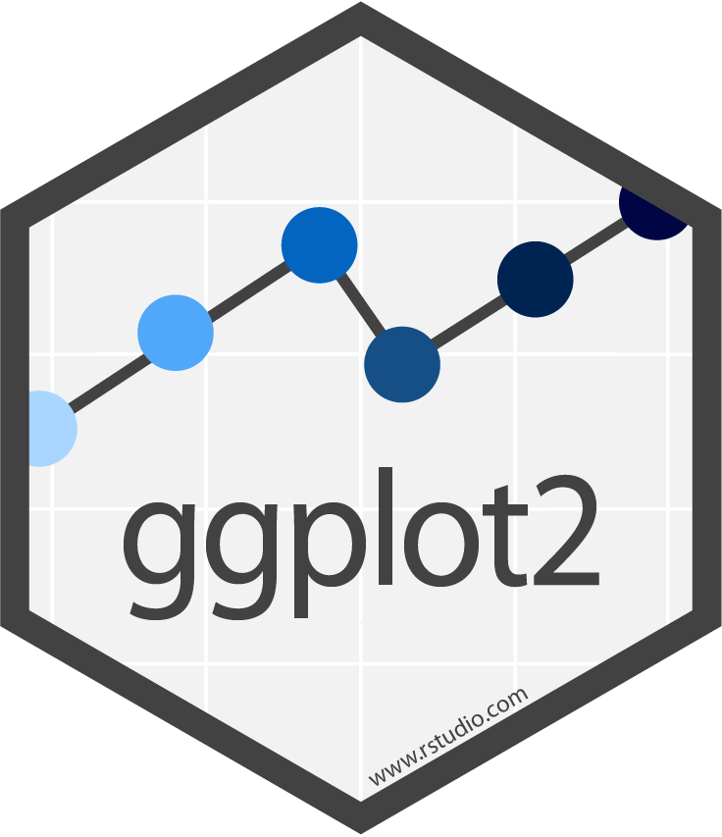
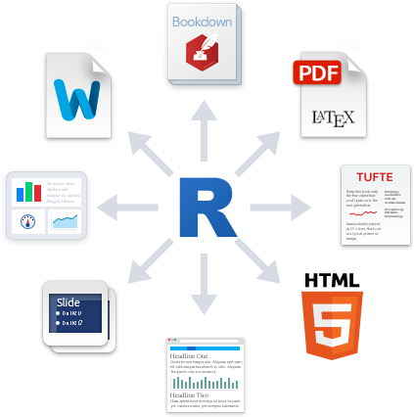
Example project
The steps to use R for Data Analysis
R can be used for most parts of a project workflow, from importing to reporting:
Read the data into the program
Transform and process the data to make it usable for analysis
Visualise (exploratory or explanatory)
Import
Transform
Visualise
Cleanup
Analyse
Report
Prepare the data by removing the useless and tidying it
Analyse and model the data to answer the research question
Report (in a PDF) and showcase the output, e.g. as a webapp
10

Slide 11
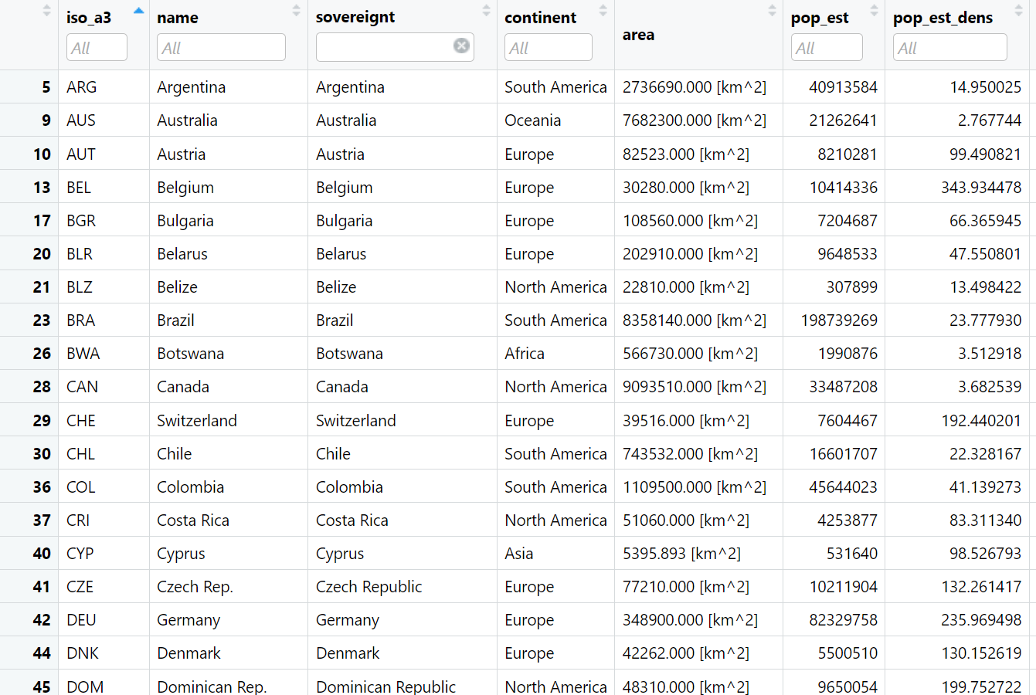
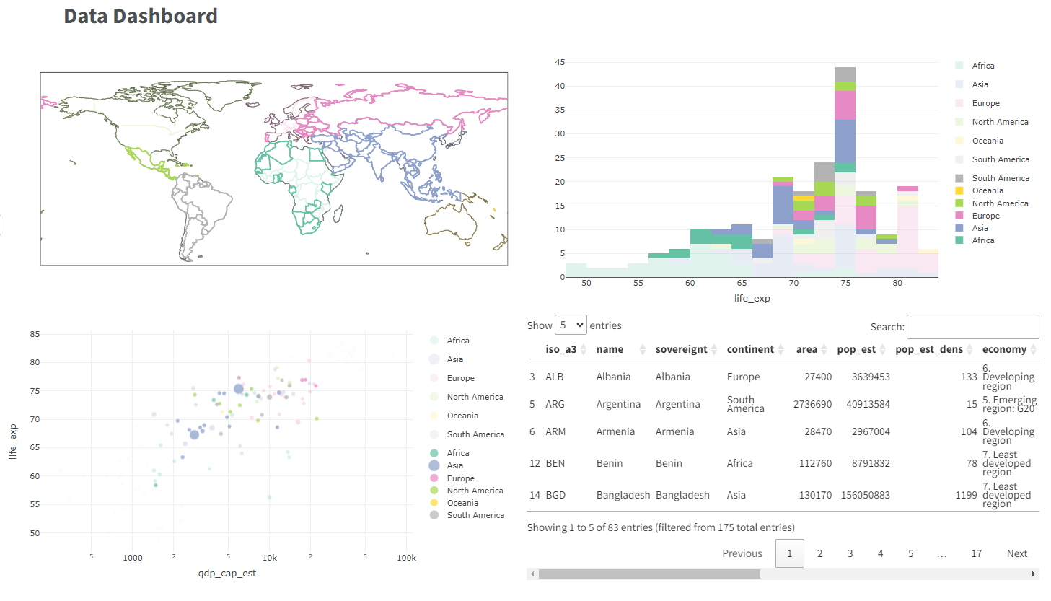
Example project
The input and output R can provide
Raw Data Input
Data Dashboard Output

Slide 12
03
Online Resources
Freely Available Ways to Learn

Slide 13
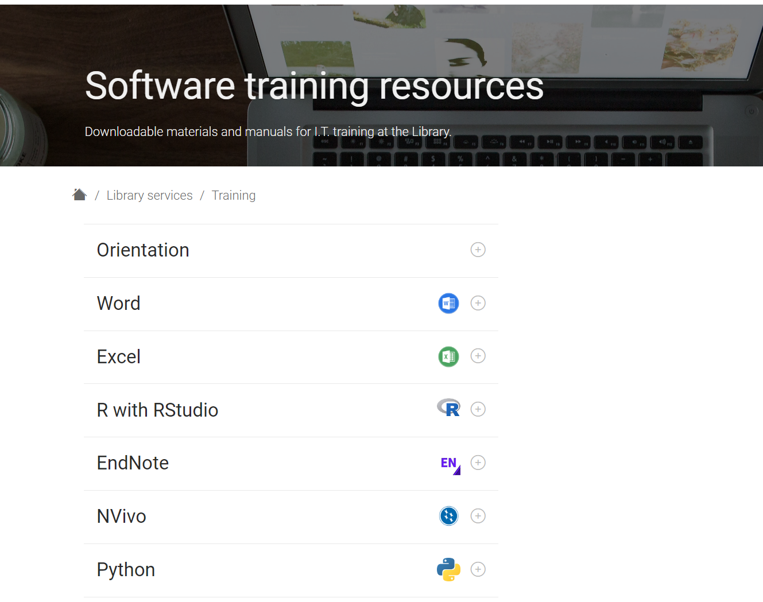
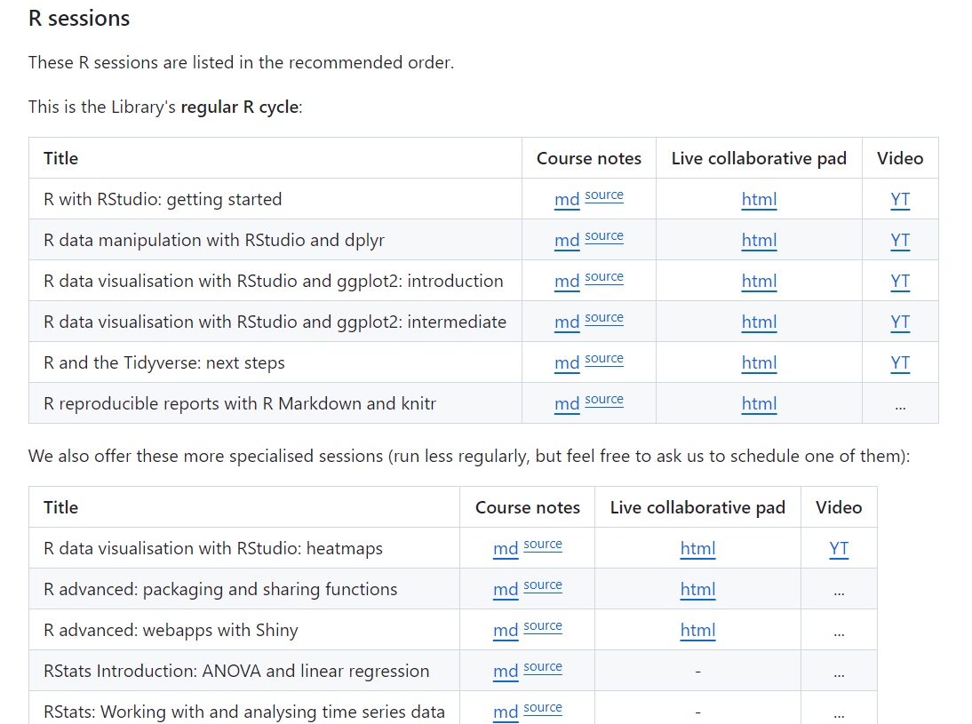
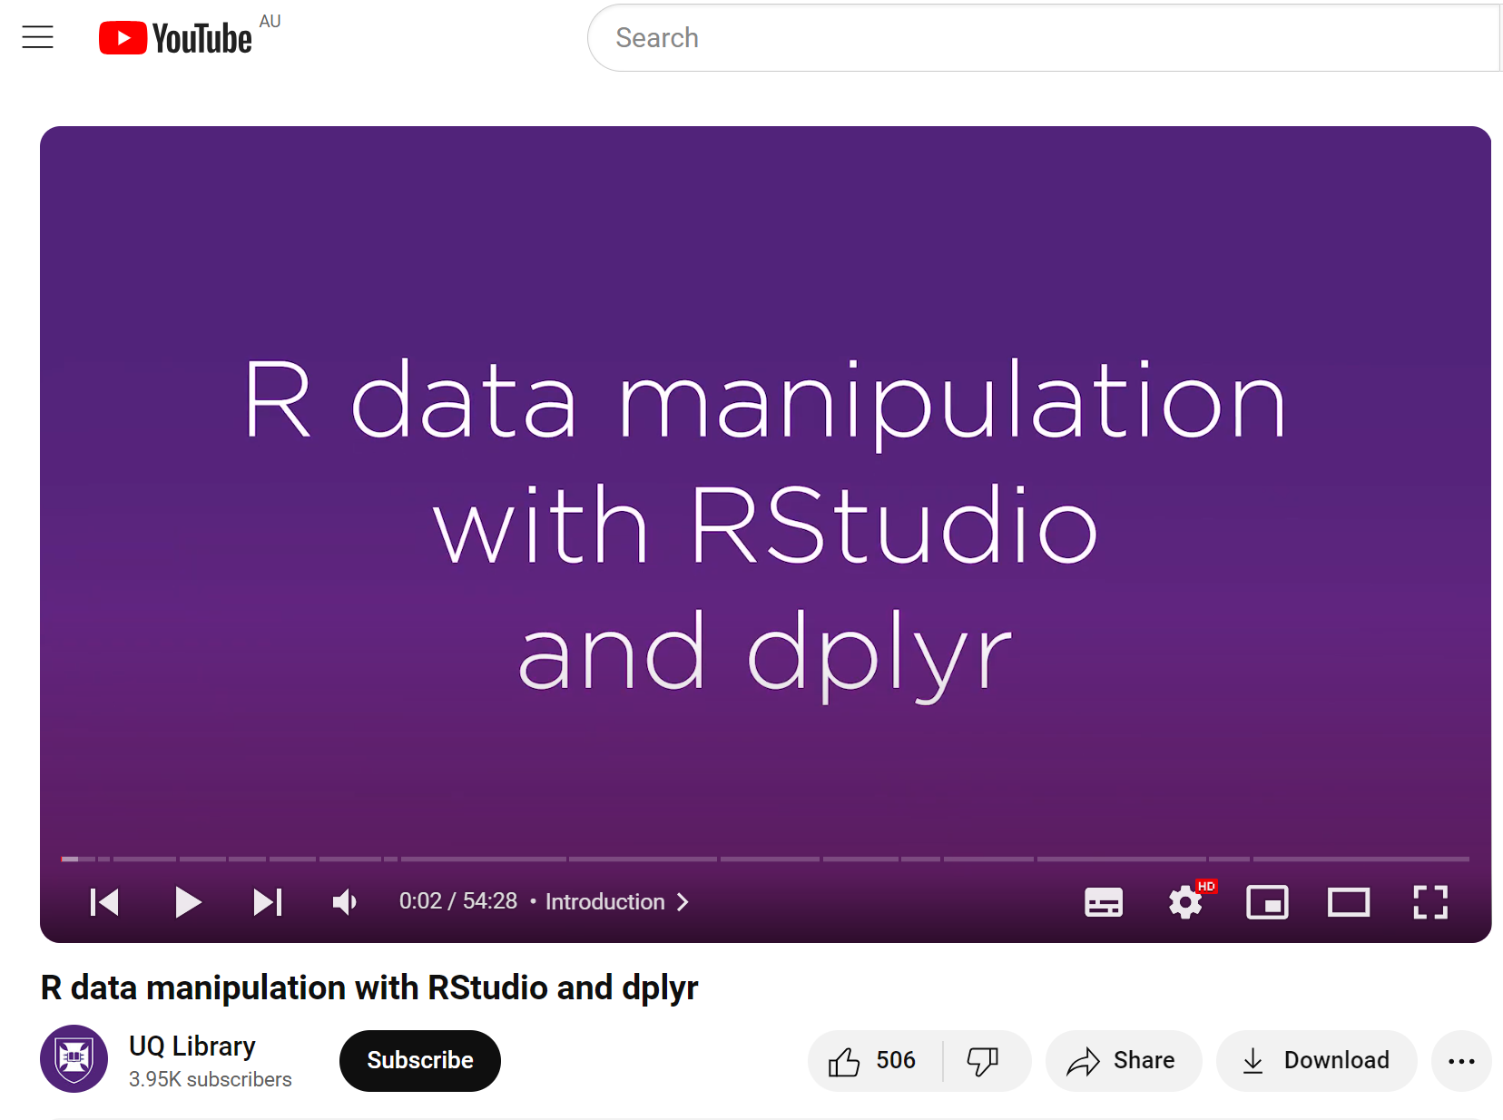
UQ Library’s Online Resources
UQ Library Training Resources
UQ Library GitHub Resource Repository
UQ Library Data Science with R and RStudio YouTube Playlist

Slide 14
More Online Resources
Compilation of Tutorials, Manuals, Documentation, Practice Exercises and More
Useful Links for R and RStudio
Useful Links for Python

Slide 15
04
Interactive Data Analysis
Programming Language

Slide 16
Files for today
All of today’s files are located on Google Drive
https://tinyurl.com/y9zf73j9
Option 1 – Using RStudio (preferred)
Download all files inside “RStudio files”
Open “Data Analysis with R.proj” with Rstudio
Option 2 – Using Google Colab
Open “Data Analysis with R.ipynb” in your browser.
You will need to log in to run the code

Slide 17
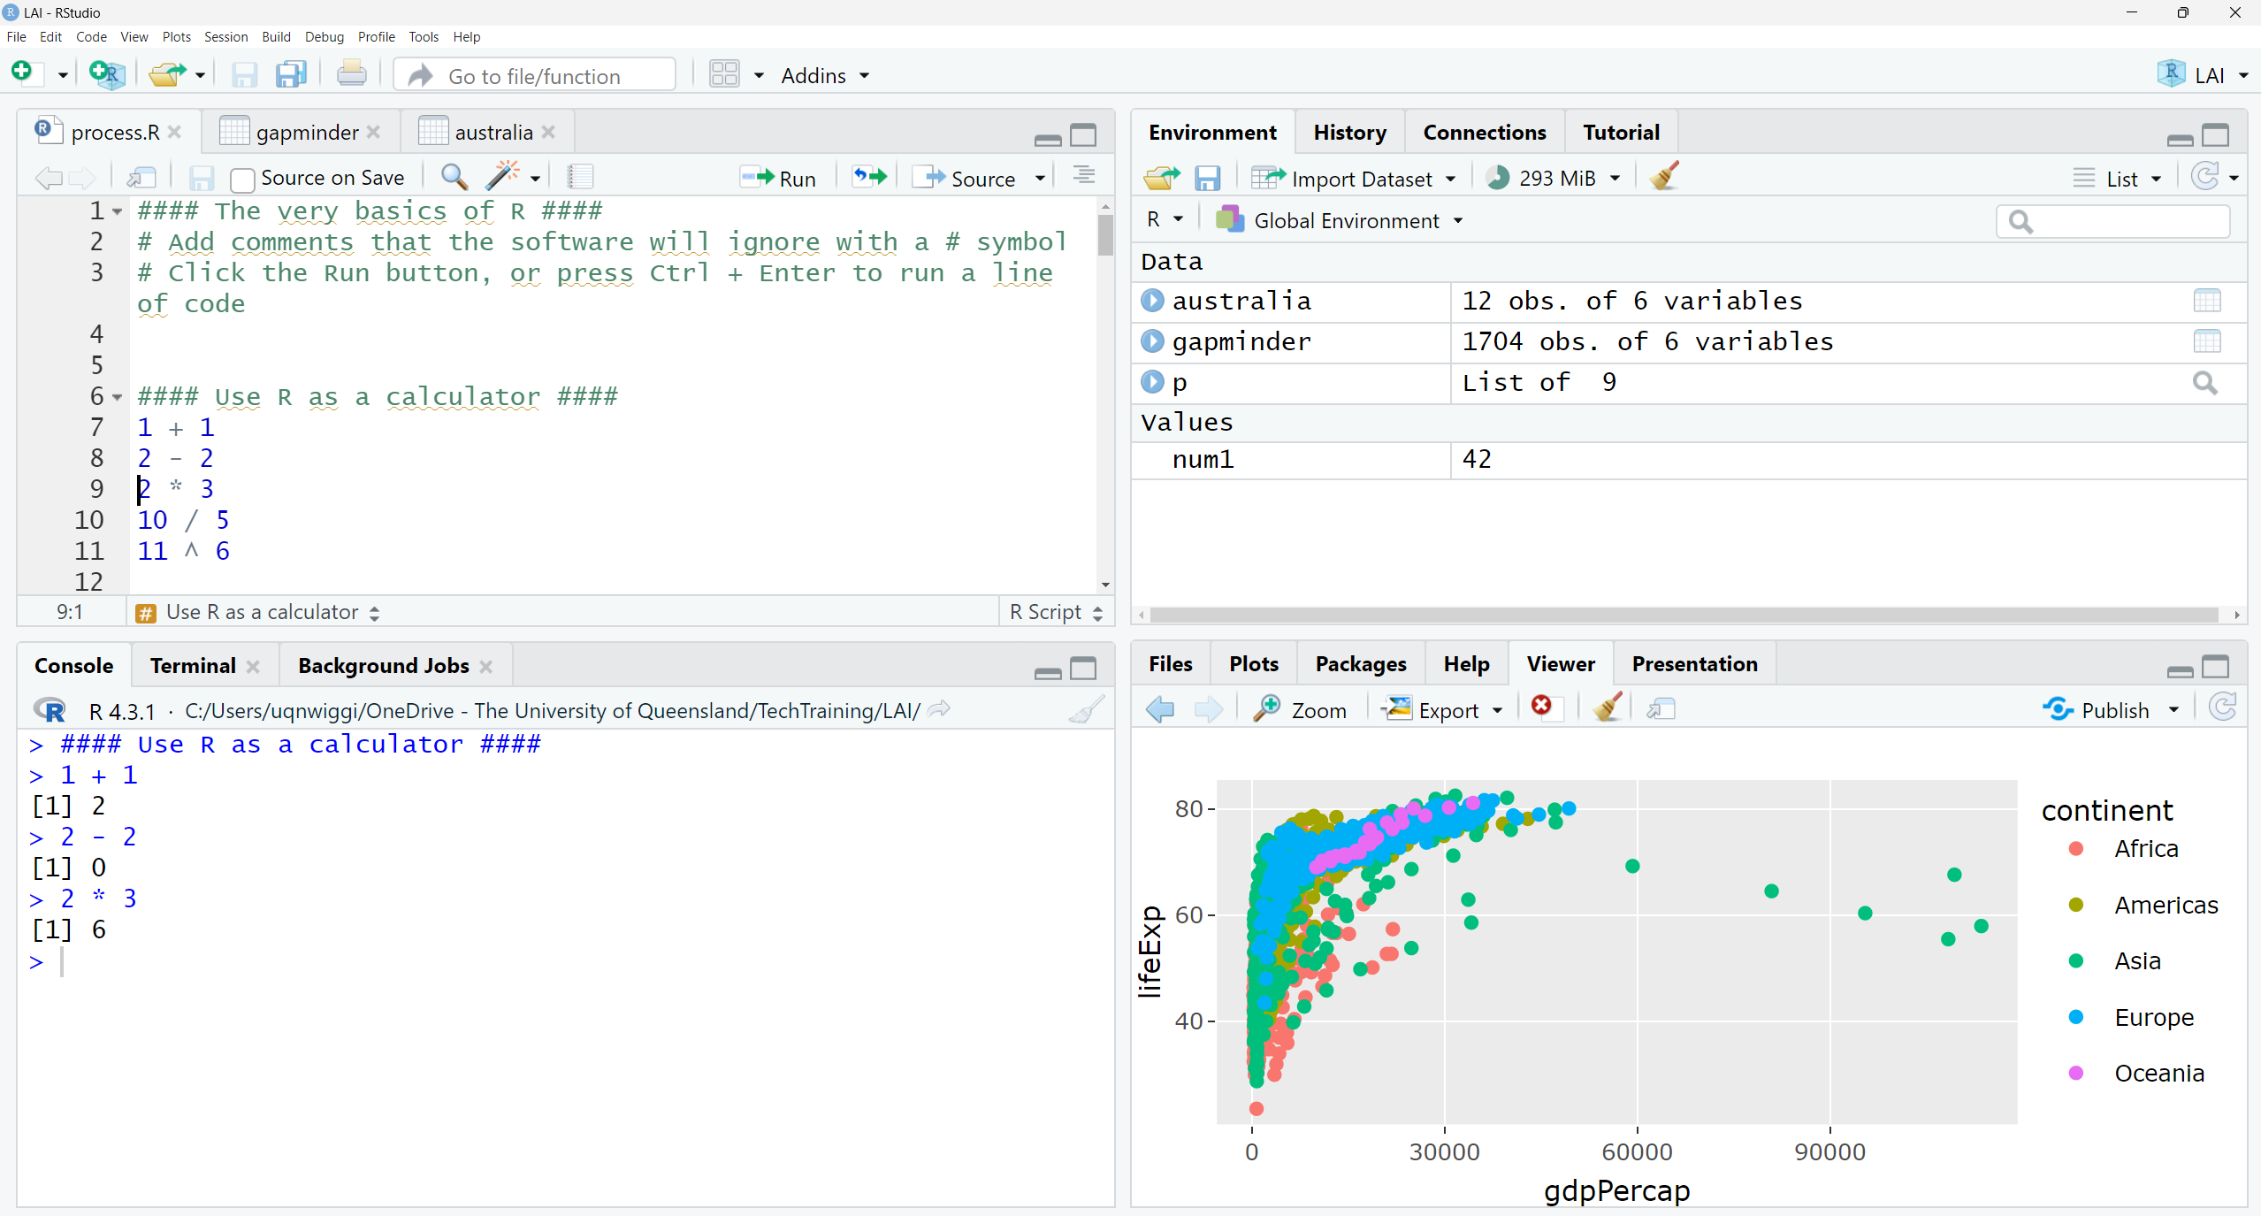


Slide 18

The Basics of R
You can use R as a calculator
1 + 1
2 – 2
2 * 3
10 / 5
11 ^ 6
You can store Variables to recall later using <-
num1 <- 42
num1
num1 * 2
You can use specific Functions for complex tasks
R follows a simple logic and syntax
round(5.5)

Slide 19
Using Packages
Before you can use a new package, you need to install it.
For example this will install a package for visualisation
install.packages("ggplot2")
When you need functions from a package you have installed, you then load it each time you open R with the library() function
library(ggplot2)
Packages in R allow you to import different functions that have more features

Slide 20
Importing Data
This function will download a file that we specify and import it into R for processing and analysis. In this case it is a csv file with world economic data called gapminder.
gapminder <- read.csv("https://raw.githubuserco
ntent.com/resbaz/r-novice-gapminder-files/mast
er/data/gapminder-FiveYearData.csv")
20

Slide 21
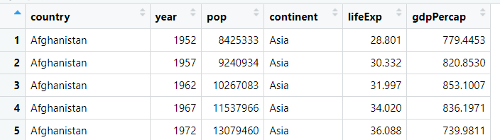
Viewing Data
Let’s view the data now
View(gapminder)
21

Slide 22
Processing Data
First we will install and load a package that is good for data transformation
install.packages("dplyr")
library(dplyr)
We can then filter to choose specific rows of data
australia <- filter(gapminder, country == "Australia")

Slide 23
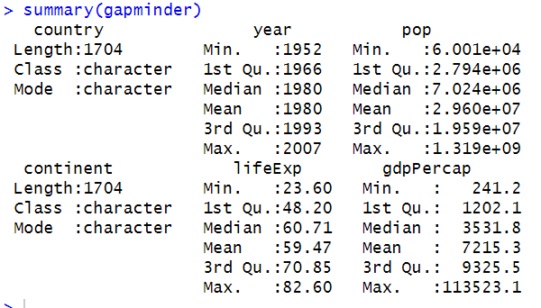
Analysing Data
There are many ways to analyse data in R. Today we will only use simple summary statistics.
summary(gapminder)

Slide 24
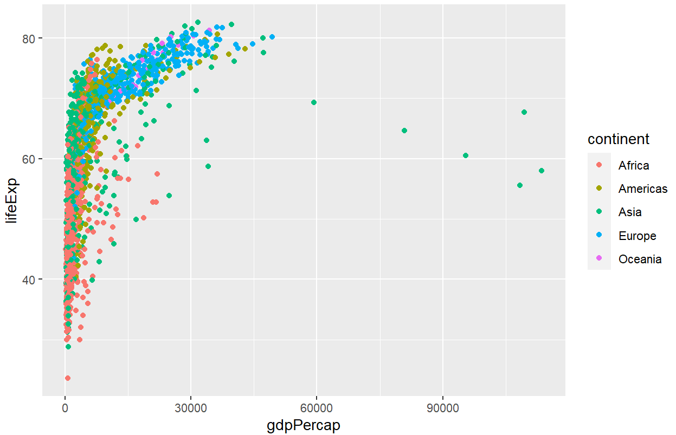
Visualising Data
We can now use the visualisation package we loaded earlier: ggplot2
This will allow us to create a scatterplot
ggplot(data = gapminder,
mapping = aes(x = gdpPercap,
y = lifeExp)) + geom_point(aes(colour = continent))
24

Slide 25
Exporting Interactive Plots
First we will install and load a package that creates interactive plots
install.packages("plotly")
library(plotly)
Next we insert our plot into a variable
p <- ggplot(data = gapminder,
mapping = aes(x = gdpPercap,
y = lifeExp)) + geom_point(aes(colour = continent))
We can now create an interactive plot
ggplotly(p)
Now we can export the plot as a HTML file
htmlwidgets::saveWidget(ggplotly(p), "index.html")
25

Slide 26

05
Jupyter Notebooks
An intuitive, interactive Python (and R!) + text document

Slide 27
Jupyter Notebooks
Code + Text in the same place!
Jupyter notebooks are files containing Python and Markdown (text)
Writing code in small chunks (cells), you can describe and annotate with formatted text (markdown)
Python is the primary language, but R is supported
Files have the .ipynb extension
Advantages
Interactive and user-friendly
Great for collaboration
With good formatting, can be used for reports etc.
Open source

Slide 28
Jupyter Notebooks
An example
Where can I run them?
Typically, .ipynb files are opened with Jupyter
Since they’re open source, there’s other options too!
Today’s example
Google Colab is a free Jupyter Notebook cloud server.
Open Introduction to Jupyter Notebooks.ipynb
All of today’s files are located on Google Drive
https://tinyurl.com/y9zf73j9

Slide 29

06
GitHub
Version control and collaboration

Slide 30
GitHub
Version control and collaboration
What is GitHub?
A cloud hosting platform designed for developers
Version control managed by Git
So, what is Git?
Software that keeps track of how documents change
Updating any file now looks like
Edit and commit the changes
Stage + push them to a repository
Sync / pull any changes other people made
Why use it?
Keeping track of changes to any file (including data) is safe!
Forking allows you to make changes without affecting the “main” branch, which you can later merge or remove
Collaboration is made easy – multiple users can commit
An example
https://github.com/camwest5/WRP_demo

Slide 31
Any Questions?
Cameron West
UQ Library Technology Trainer
training@library.uq.edu.au
CRICOS 00025B • TEQSA PRV12080

